Slide 2

Project: Taxonomic capacity building to support market
access for agricultural trade in the ASEAN region
Donor: Approved for funding by the Japan-ASEAN
Integration Fund (JAIF) on 15th April 2015
Duration: Two years starting 1st May 2015 to 30th April 2017.
Gross Project Value: US$ 892,354.10
Another ARDN activity, complementing the capacity building program provided under the AANZFTA ECWP

Slide 3
Project Objective:
Develop and strengthen capacities among the ASEAN Member States (AMS) in taxonomic knowledge to be able to accurately diagnose and identify pests and diseases and manage quarantine risks associated with agricultural commodities
Administrative Components:
  - Training and Capacity Building
  - Networking and Institutionalization
  - Management and Coordination
Technically:
Training workshops on the taxonomy of 3 pest groups with follow-on attachment program in laboratories of experts

Slide 4
Activity 1.1 Training Workshop on Diagnostics of Plant Viruses
- at Crop Science Cluster, College of Agriculture, University of the
Philippines – Los Baños from 17-28 August 2015
- 19 plant pathologists from Brunei Darussalam, Cambodia, Indonesia,
Lao PDR, Malaysia, Myanmar, Philippines, Thailand and Vietnam
attended
- Resource persons from Tokyo University of Agriculture (Prof. K.
Natsuaki), Japan; Bogor Agricultural University (Prof. Sri Hendrastuti
Hidayat), Indonesia and from IPB-UPLB (Dr. Marita Pinili and her team).
Attachment Program on Plant Viruses
- at the Laboratory of Tropical Plant Protection, Tokyo University of
Agriculture (Tokyo NODAI), Japan from October 26 – December 25, 2015
- Nur Fitriawati, IAQA Indonesia, Norhayati binti Madiha, Biosecurity
Division DoA Malaysia, and Tran Van Chien, PEQ MARD Vietnam

Slide 5
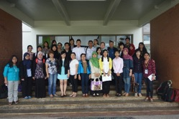
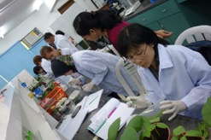
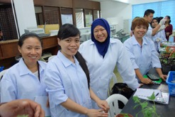
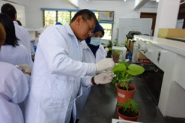
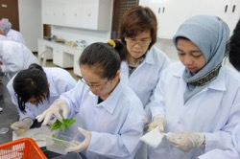
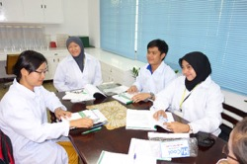
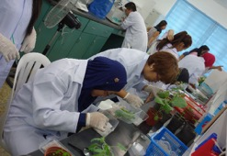
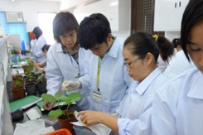
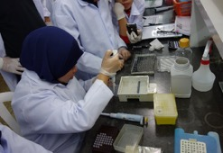
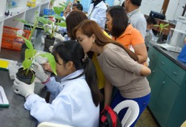
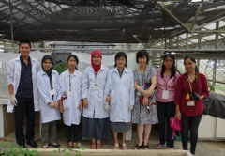
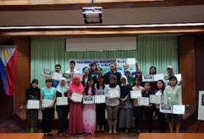
Training Workshop on Diagnostic of Plant Viruses

Slide 6
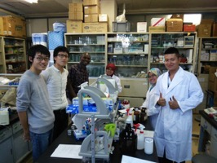
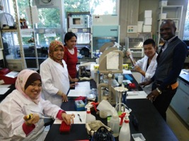
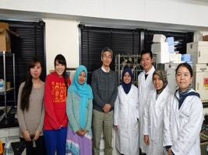
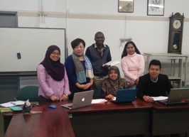
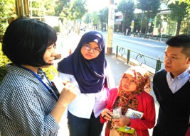
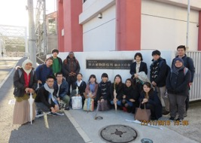
Attachment Program on Diagnostic of Plant Viruses at Tokyo University of Agriculture (NODAI), Japan

Slide 7
Activity 1.2. Training Workshop on Diagnostics of Leafminers of Agricultural Importance
- at Museum Zoologicum Bogoriense, Centre for Research Development in Biology,
LIPI, Cibinong, Bogor, Indonesia from 29 February to 11 March 2016
- 20 entomologists from Brunei Darussalam, Cambodia, Indonesia, Lao PDR, Malaysia,
Myanmar, Philippines, Singapore, Thailand and Vietnam attended
- resource persons from Nara Women University, Japan (Prof. Hiroaki Sato); School of
Applied Systems Biology, La Trobe University, Australia (Assoc. Prof. M. Malipatil),
and Museum Zoologicum Bogoriense Bogor (Dr. Hari Sutrisno, Prof. Rosichon
Ubaidillah and Dr. Awit Suwito and his team)
Attachment Program on Leafminers and their Natural Enemies
- Yuvarin Boontop, DoA Thailand and Ariene Garcia Castillo, AVA Singapore selected
for attachment program on leafminers taxonomy scheduled from 1st August to 30th
September 2016 at Nara Women University, Japan under the supervision of Assoc.
Prof. Hiroaki Sato
- Attachment program on natural enemies of leafminers at Museum Zoologicum
Bogoriense for selected candidate from Brunei being arranged pending govt approval

Slide 8
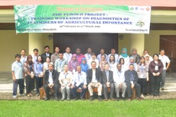
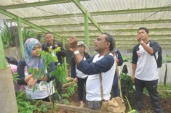
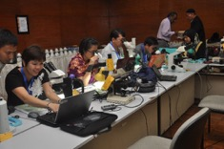
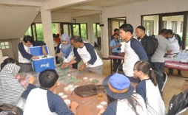
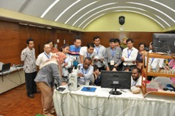
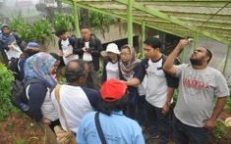
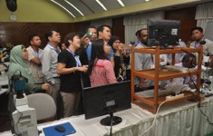
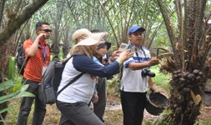
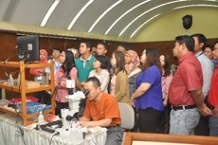
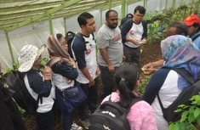
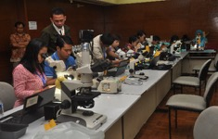
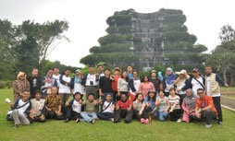
Training Workshop on Diagnostic of Leafminers of Agricultural Importance

Slide 9
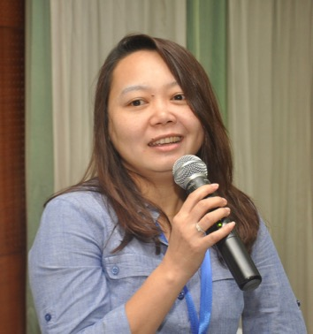
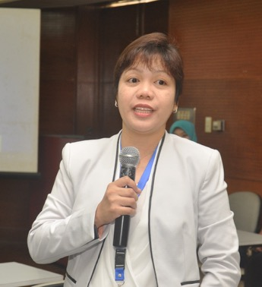
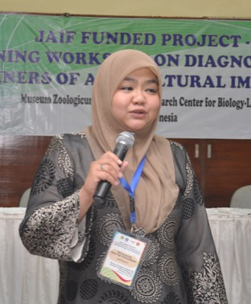
Attachment Program on Leafminers of Agricultural Importance
At Nara Women University (2 persons), Japan and LIPI, Bogor – Indonesia (1 person)
Thailand Singapore Brunei Darussalam

Slide 10
Activity 1.3. Training Workshop on Diagnostics of Aphids of Agricultural Importance
This training workshop has been planned to be organized in Thailand, pending confirmation from the identified Japanese resource person, Prof. Shin-ichi AKIMOTO, Laboratory of Systematic Entomology, Graduate School of Agriculture, Hokkaido University.
Attachment Program on Aphids of Agricultural Importance

Slide 11
  Activity 2.1. A website for the project http://www.aseanet.org/JAIF1.asp has been developed and is now up and running.
  The website serves:
  a) as a repository for all activities, updates, news and reports for the project;
  b) communication, publicity and awareness where the project is publicized to
  stakeholders and where project partners communicate and interact; and
  c) knowledge exchange where the website serve as a platform for sharing knowledge
  and resources for taxonomy.
  The website has sections on project activities, news, gallery showcasing images from workshop and project activities, resources where project documents are uploaded, expert register and content management system. Project documents are behind a password protected section and logins will be provided to project partners for download.
  The expert register comprises information and contact details of individual experts and diagnostic laboratories that provide identification and diagnostic services and facilities for plant pests and diseases.

Slide 12
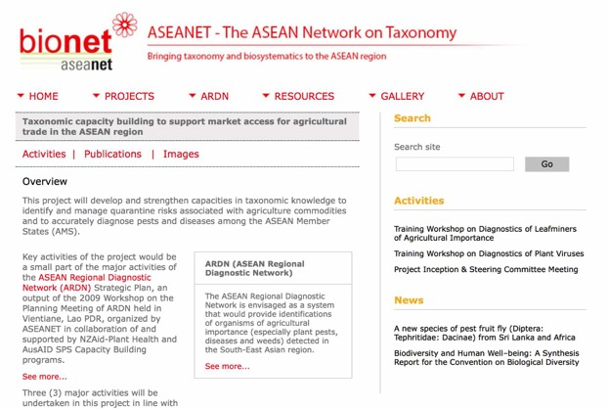
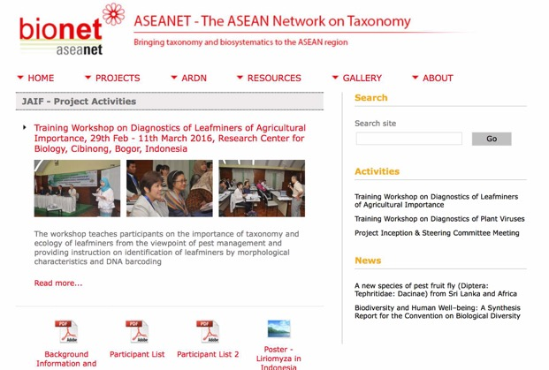
http://www.aseanet.org/JAIF1.asp

Slide 13
PROPOSED 2nd PHASE OF JAIF PROJECT
Current project has been scheduled to be completed by April 2017.
During the Project Inception Meeting held in July 2015, a list of potential activities have been proposed and endorsed by the Project Steering Committee (PSC) for further consideration and approval by the ASEAN NPPOs. These, together with proposals offered by resource persons during the training workshops and attachment programs have been circulated by e-mail to NPPOs of AMS to be ranked based on their respective country priorities. The result of this exercise is given in ANNEX 1.
Ten activities have been selected for incorporation into a request for a Phase 2 funding support by JAIF. The full proposal of the 2nd Phase Project would be prepared after approval is secured and after consultation with the relevant authority in Japan.
The meeting is requested to endorse the list of possible activities for approval by the SOM Meeting.

Slide 14
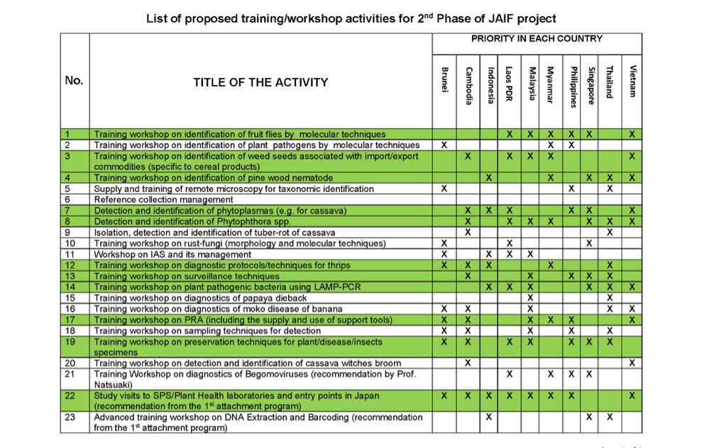
Annex 1. Prioritized Topics for a Second Phase to the Project

Slide 15
Annex 1. Prioritized Topics for a Second Phase to the Project
No. | Topic
1 | Identification of fruit flies by molecular techniques
2 | Identification of weed seeds associated with cereal commodities
3 | Study visit to SPS/Plant Health laboratories and entry points in Japa
4 | Detection and identification of phytoplasmas (e.g. for cassava)
5 | Detection and identification of Phytophthora spp.
6 | Diagnostic protocols/techniques for thrips
7 | Training pest surveillance techniques
8 | Application of LAMP-PCR in the identification of plant pathogenic bacteria
9 | Pest risk analysis
10 | Preservation and management of plant/disease/insect specimens

Slide 16



